Slide 1
ENSE 470: Milestone 2
Team Dancing to Zebras
Tristan Heisler, Demitri Kourles and Zuoxiu Xing
January 25th, 2018

Slide 2
Identified Kaizen Bursts
Multiple methods of requesting access to the software tools causing over-processing, transportation and excessive movement.
Software users being unaware of who the approvers are causing over-processing and defects.
Unsorted and separately-maintained files documenting approvers causing over-production and over-processing.
Approvers being contacted a second time for confirmation causing over-processing, defects and waiting.

Slide 3
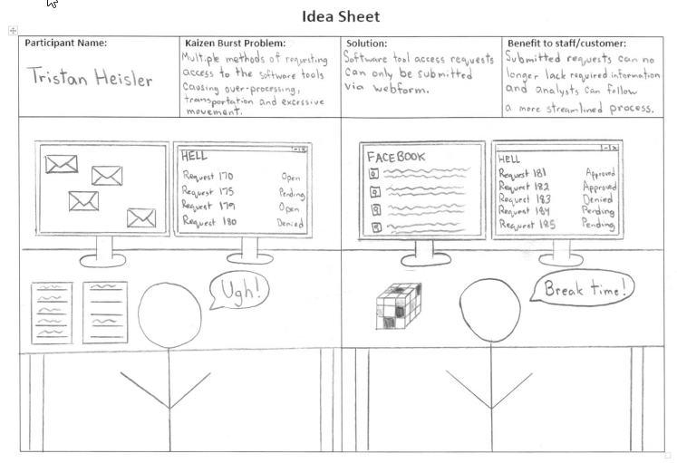
Category: Communication Process

Slide 4
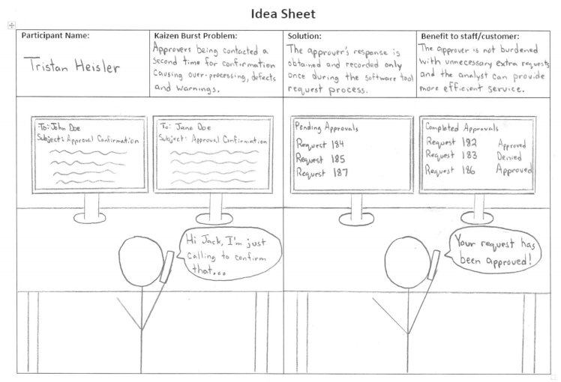
Category: Communication Process

Slide 5
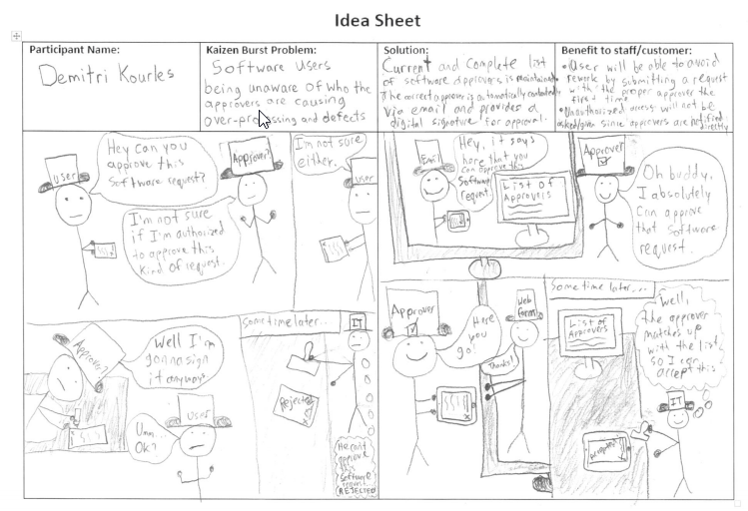
Category: Approval Process

Slide 6
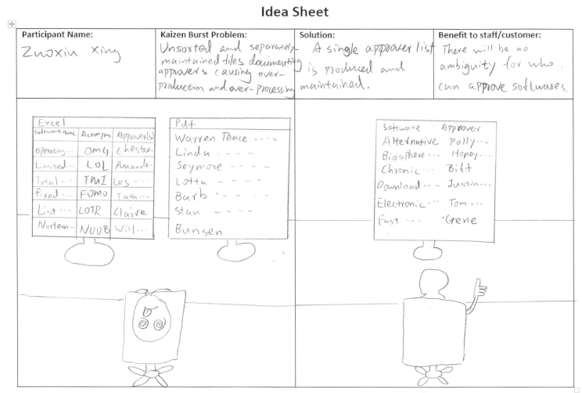
Category: Approval Process

Slide 7
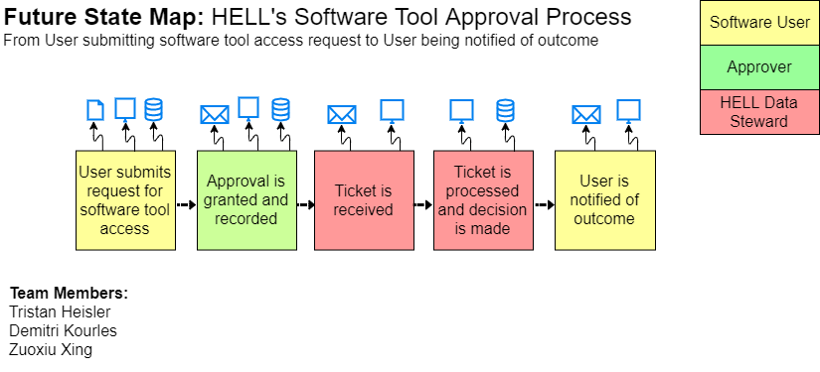

Slide 8
Values of the Future FSM
Eliminated waste:
Utilizing only a webform to request access ensures that data cannot be omitted and eliminates rework, over-processing and movement.
A single sorted list of approvers eliminates over-production and over-processing.
Improved flow:
Streamlining the process improves efficiency, decreases wait times and allows the user to be notified of the outcome earlier.
This model and associated idea sheets will be referenced during discussion and implementation of the improved software.

Slide 9
Group Reflection
How did you feel about this milestone? What did you like about it? What did you dislike?
We liked being able to discuss potential solutions to previously-identified issues. Although we disliked the amount of time required to develop the idea sheets, we can appreciate their value.
What did you learn about yourself as you collaborated and worked through this milestone?
It was reinforced that multiple potential solutions exist for a particular problem. Team discussion was utilized to agree upon a single solution.
How will you use what you have learned going forward?
Within this project, we will use our idea sheets and Future State VSM to guide future development. In our future careers, such documents can be utilized to provide a non-technical overview of the system to stakeholders so that they can be adjusted appropriately prior to implementation.
What “stuff & things” related to this milestone would you want help with?
No major hurdles were identified by our group for this milestone.

Slide 10
Questions?

